Slide 1
Avidity Investigation

Slide 2
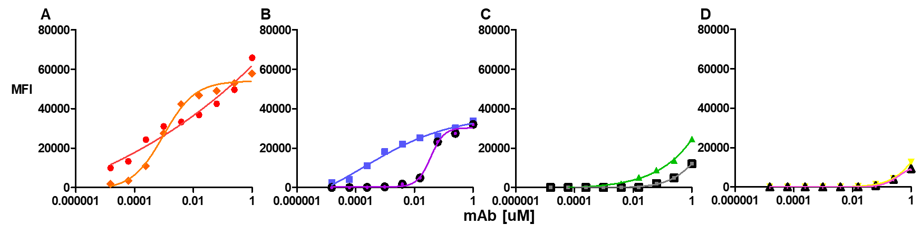
1.4nm
13nm
90nm
?
Antibodies able to bind for an hour before cells are washed
PD1 receptor number is approximately 1000

Slide 3
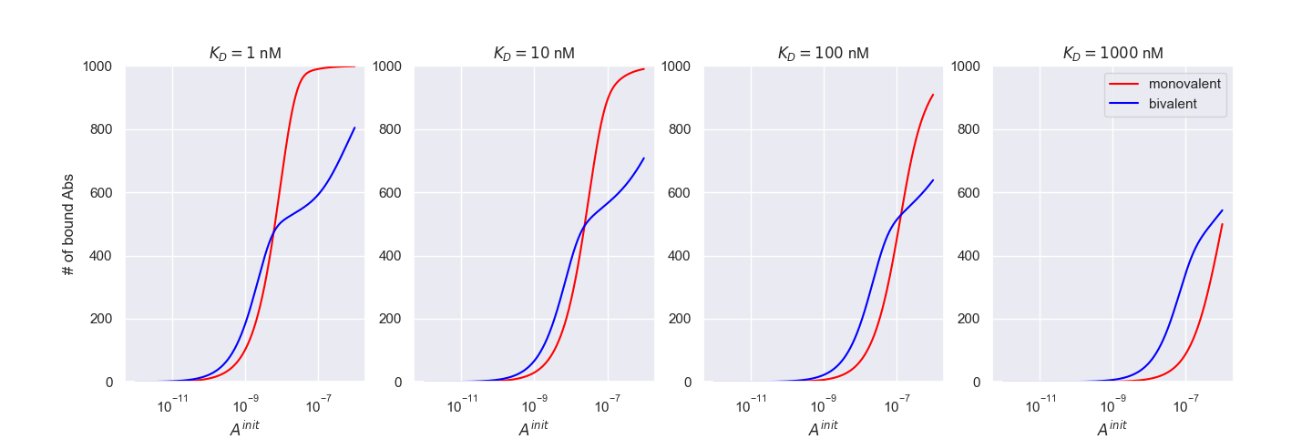
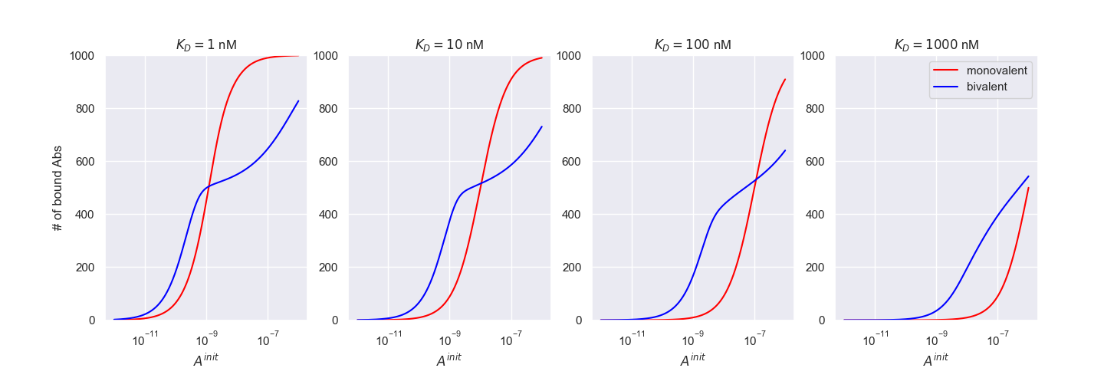
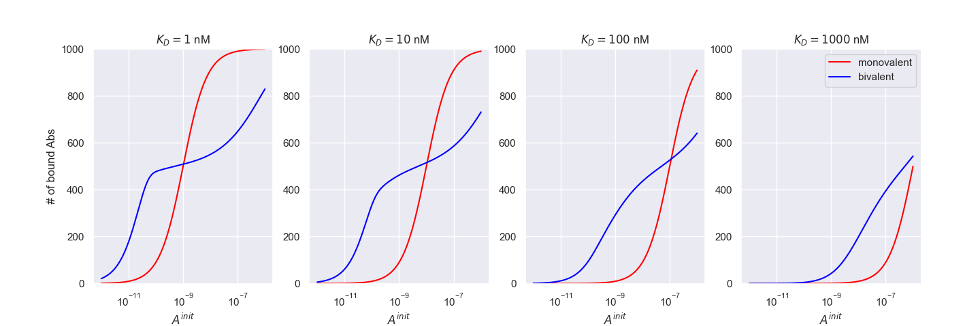
1 hour
10 hours
100 hours

Slide 4
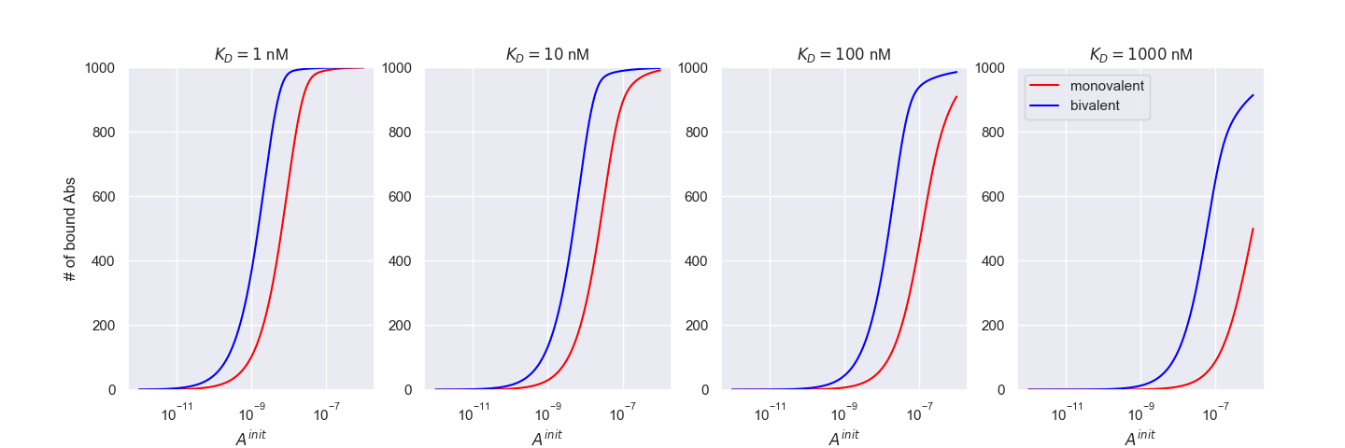
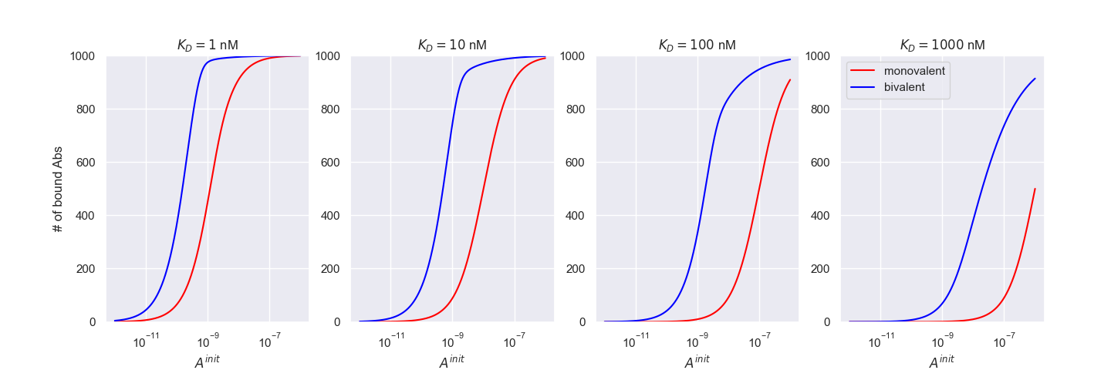
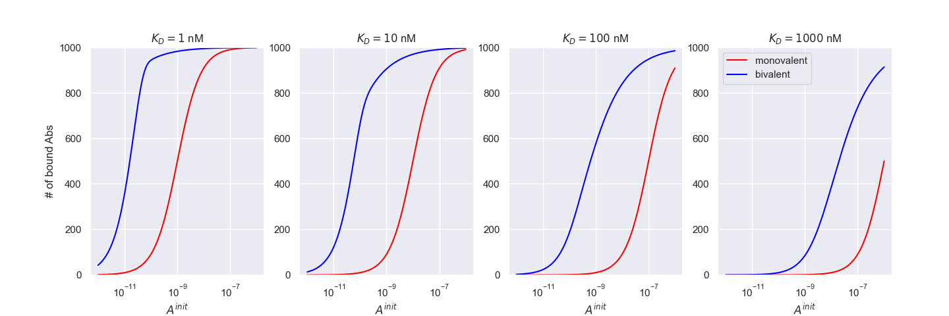
1 hour
10 hours
100 hours

Slide 5
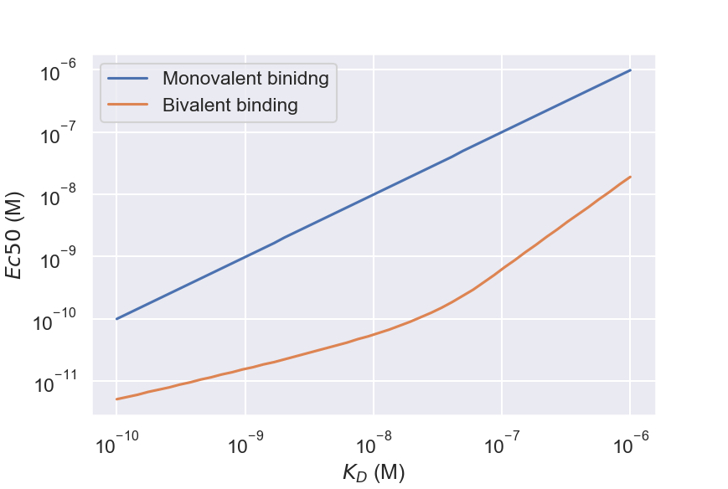
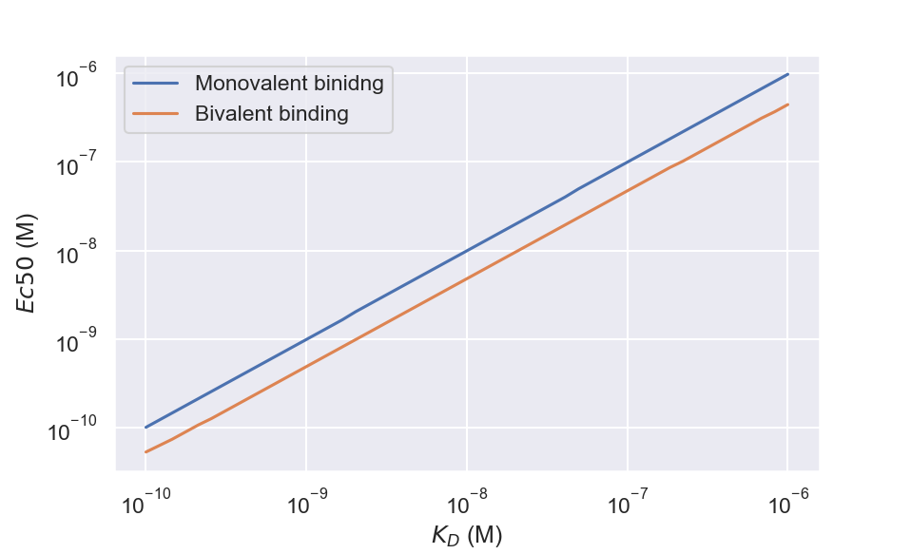
Receptor Occupancy
Number of bound antibodies

Slide 6
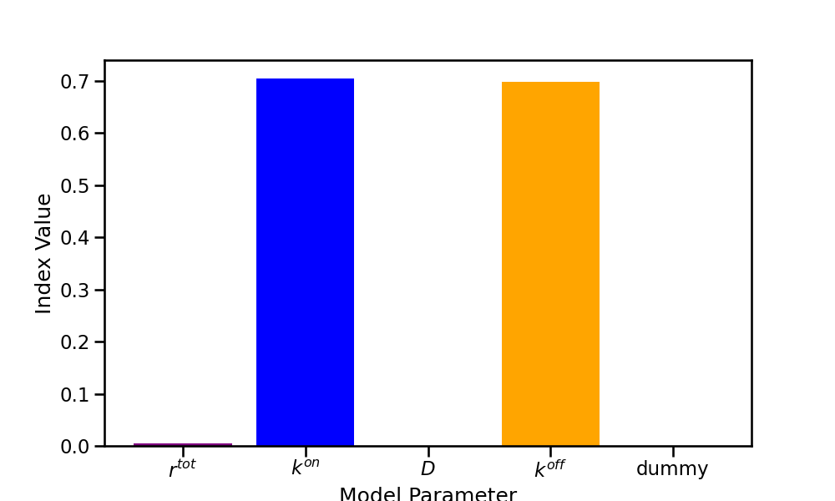
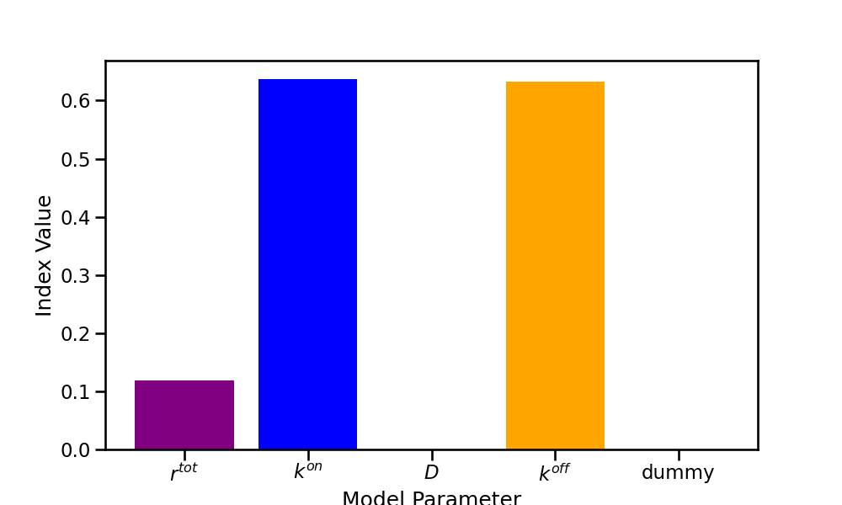
Monovalent EC50 sensitivity analysis
1e4<Rtot <1e6
1e3<Rtot <1e5

Slide 7
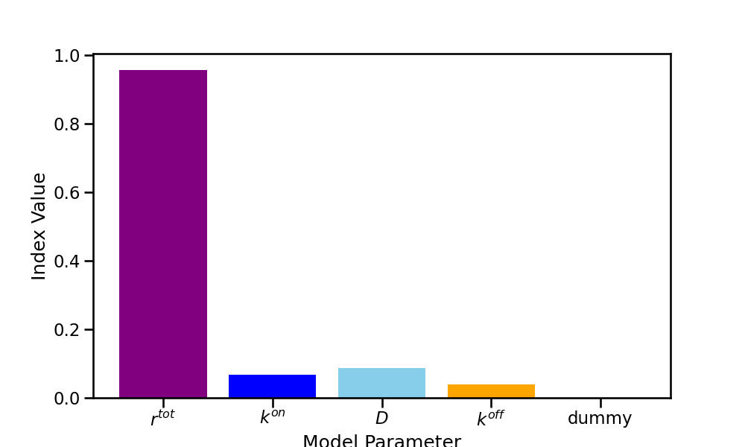
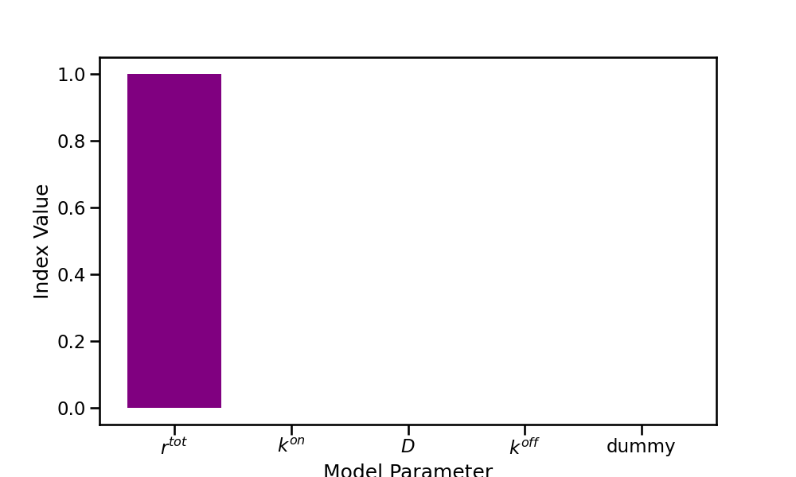
Bivalent EC50 sensitivity analysis
Bound antibody
Receptor occupancy

Slide 8
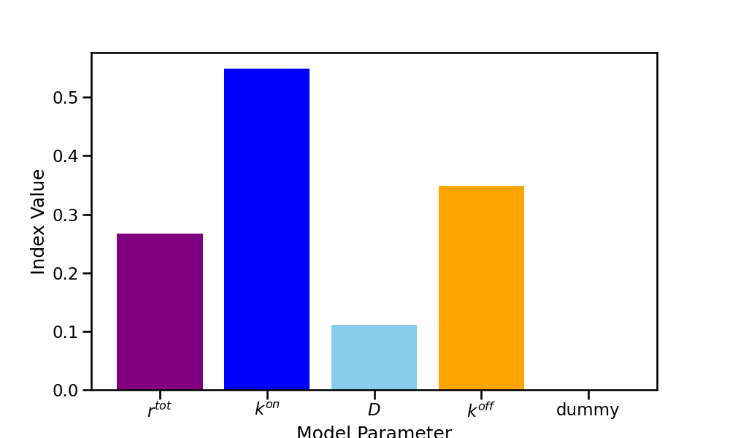
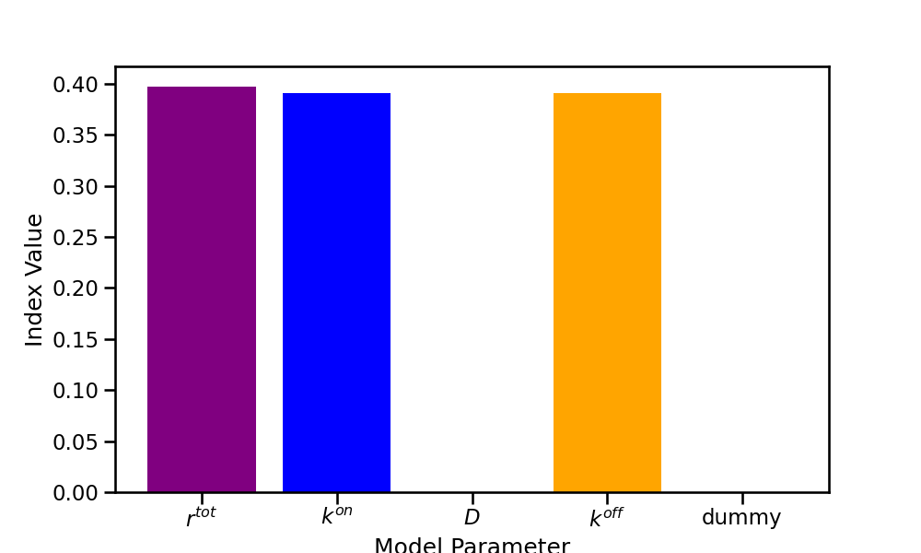
Change in EC50 Sensitivity Analysis
Bound antibody number change in EC50
Receptor occupancy change in EC50

Slide 9
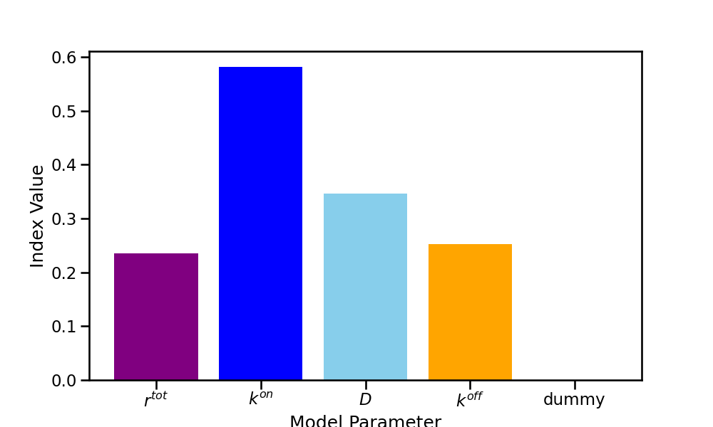
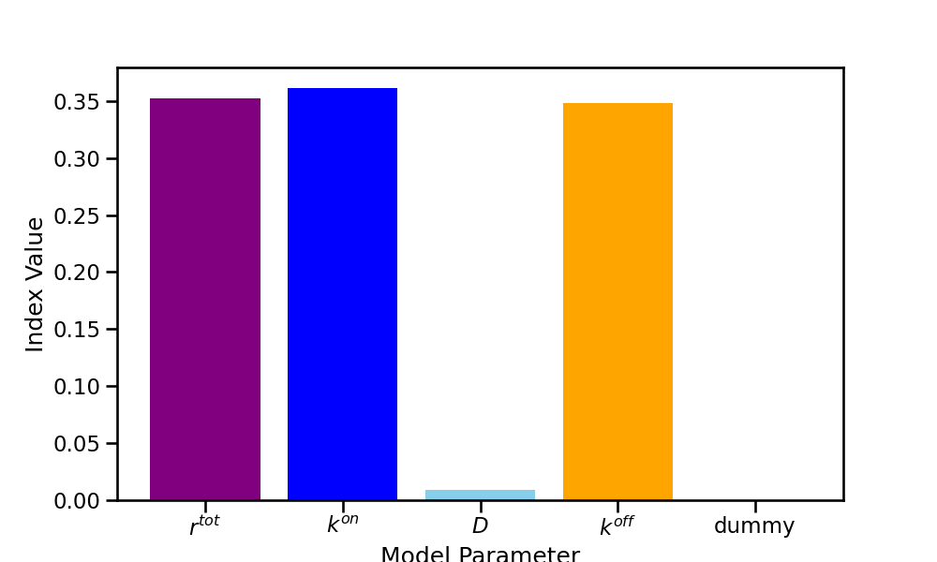
1e3<Rtot <1e5 Change in EC50 Sensitivity Analysis

Slide 10
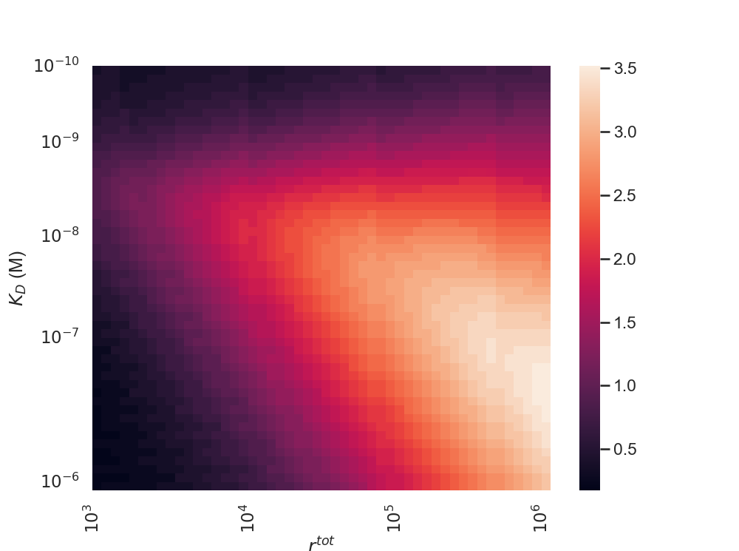
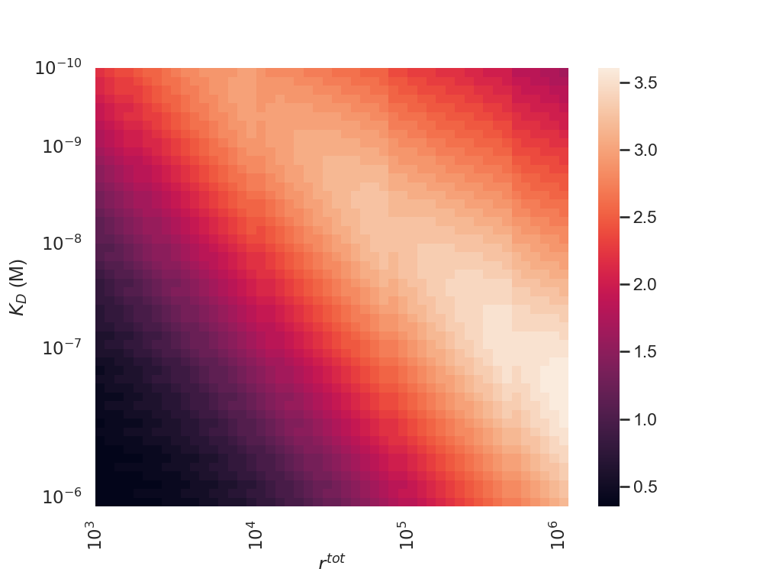
Change in EC50 heatmaps
log10(mono ec50) – log10(bivalent ec50)
Bound antibody
Receptor occupancy

Slide 11
